Slide 1
Female Reproductive System
Al-Farabi Kazakh National University
Higher School of Medicine
Oogenesis and the Sexual Cycle. Female Sexual Response

Slide 2
LEARNING OUTCOMES
As a result of the lesson you will be able to:
describe the process of egg production (oogenesis);
describe changes in the ovarian follicles (folliculogenesis) in relation to oogenesis;
describe the hormonal events that regulate the ovarian cycle;
describe how the uterus changes during the menstrual cycle;
construct a chart of the phases of the monthly sexual cycle showing the hormonal, ovarian, and uterine events of each phase.
describe the female sexual response at each phase of intercourse;
compare and contrast the female and male sexual responses.
Al-Farabi Kazakh National University
Higher School of Medicine

Slide 3
Introduction
reproductive cycle
the sequence of events from fertilization to giving birth and returning to a state of fertility
sexual cycle
the events that recur every month when pregnancy does not intervene.
controlled by shifting patterns of hormone secretion
ovarian cycle - events in ovaries
menstrual cycle - parallel changes in uterus clitoris
Al-Farabi Kazakh National University
Higher School of Medicine

Slide 4
Oogenesis
egg production
egg, or ovum – any stage from the primary oocyte to the time of fertilization
produces haploid gametes
accompanied by cyclic changes in hormone secretion
cyclic changes in histological structure of the ovaries and uterus
Difference between Spermatogenesis and Oogenesis
https://www.youtube.com/watch?time_continue=6&v=vsiZOHernd0&feature=emb_logo
Lets watch the video and list the key difference
Al-Farabi Kazakh National University
Higher School of Medicine
Notes:
Process of formation of sperms is called spermatogenesis and the process of formation of ovum is called oogenesis.
Spermatogenesis takes place in the testes and oogenesis takes place in the ovaries.
No polar bodies are formed in spermatogenesis. Two polar bodies are formed in oogenesis.
Spermatogenesis takes 74 days to complete while oogenesis takes days to years.
All stages of spermatogenesis are completed inside the testis while some processes of oogenesis is carried out outside ovaries.
The growth phase is short in spermatogenesis but long in oogenesis.
Spermatogenesis form motile make gametes but oogenesis form non-motile gametes.

Slide 5
Folliculogenesis
The development of the follicles around the egg than undergoes oogenesis
primordial follicles
consists of a primary oocyte in early meiosis
primary follicles
have larger oocytes and follicular cells that still form a single layer
secondary follicles
still larger oocytes and follicular cells now stratified (granulosa cells)
zona pellucida – layer of glycoprotein gel secreted by granulosa cells around the oocyte
theca folliculi – connective tissue around the granulosa cells condenses to form a fibrous husk
tertiary follicles
antral follicles – tertiary and mature follicles
preantral follicles – earlier stages of the follicles
cumulus oophorus – a mound of granulosa cells on one side of the antrum that covers the oocyte and secures it to the follicular wall
corona radiata – innermost layer of cells in the cumulus surrounding the zona pellucida and the oocyte
protective barrier around the egg with a similar function as the blood-testis barrier
theca folliculi continues to differentiate forming two layers
mature (graafian) follicles
normally only one follicle from each month’s cohort becomes a mature follicle destined to ovulate
Al-Farabi Kazakh National University
Higher School of Medicine

Slide 6
The Sexual Cycle
averages 28 days, varies from 20 to 45 days
basic hierarchy of hormonal control
hypothalamus→ pituitary → ovaries → uterus
. cycle begins with 2 week follicular phase
menstruation occurs during first 3 to 5 days of cycle
uterus replaces lost tissue by mitosis and cohort of follicles grow
ovulation around day 14 –remainder the of follicle becomes corpus luteum
next 2 weeks the luteal phase
corpus luteum stimulates endometrial secretion and thickening
if pregnancy does not occur, endometrium breaks down in the last 2 days
menstruation begins and the cycle starts over
Al-Farabi Kazakh National University
Higher School of Medicine

Slide 7
The Ovarian Cycle
follicular phase
extends from the beginning of menstruation until ovulation
FSH stimulates continued growth of the cohort, but the dominant follicle above all ,FSH stimulates the granulosa cells of the antral follicles to secrete estradiol
ovulation phase
the rupture of the mature follicle and the release of its egg and attendant cells
estradiol stimulates a surge of LH and a lesser spike of FSH by anterior pituitary
luteal (Postovulatory) phase
just after ovulation to the onset of menstruation
transformation from ruptured follicle to corpus luteum is regulated by LH
progesterone has a crucial role in preparing the uterus for the possibility of pregnancy
LH and FSH secretion declines over the rest of the cycle
high levels of estradiol and progesterone, along with inhibin from the corpus luteum has a negative feedback effect on the pituitary
if pregnancy does not occur, the corpus luteum begins the process of involution (shrinkage)
Al-Farabi Kazakh National University
Higher School of Medicine

Slide 8
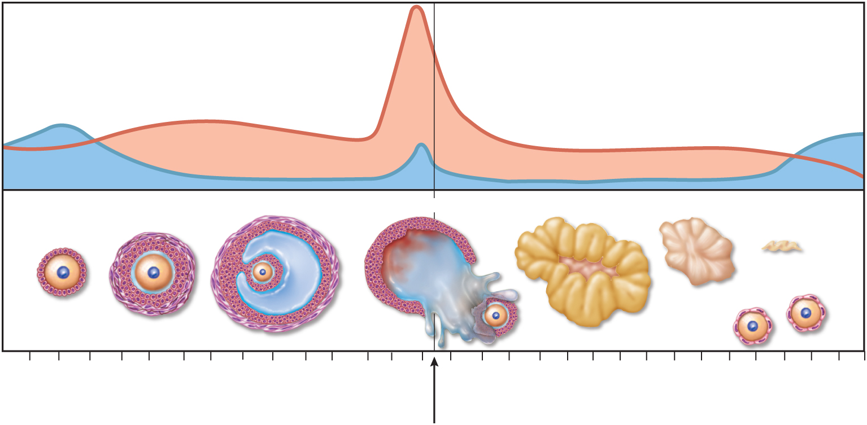
Ovarian Cycle - Luteal Phase
Copyright © The McGraw-Hill Companies, Inc. Permission required for reproduction or display.
(a) Ovarian cycle
LH
Gonadotropin secretion
FSH
Developing follicles
Tertiary
Ovulation
Corpus luteum
Involution
Corpus
albicans
Primary
Secondary
Ovarian events
New primordial
follicles
Days
1
3
5
7
9
1
1
13
15
17
19
21
23
25
27
1
Follicular phase
Luteal phase
Figure from: Saladin, Anatomy & Physiology, McGraw Hill, 2018
Figure 28.14a

Slide 9
Signs of Ovulation
couples attempting to conceive a child or avoid pregnancy need to be able to tell when ovulation occurs
cervical mucus becomes thinner and more stretchy
resting body temperature rises 0.4° to 0.6° F
best measured first thing in the morning before arising from bed
record for several days to see the difference
LH surge occurs about 24 hours prior to ovulation
detected with home testing kit
twinges of ovarian pain (mittelschmerz)
lasts from a few hours to a day or so at the time of ovulation
best time for conception
within 24 hours after the cervical mucus changes and the basal temperature rises

Slide 10
Menstrual Cycle
consists of a buildup of the endometrium during most of the sexual cycle, followed by its breakdown and vaginal discharge
proliferative phase layer of endometrial tissue (stratum functionalis) lost in the last menstruation is rebuilt
secretory phase – endometrium thickens still more in response to progesterone from corpus luteum
premenstrual phase – period of endometrial degeneration
menstrual phase – discharge of menstrual fluid from the vagina (menses)
Al-Farabi Kazakh National University
Higher School of Medicine

Slide 11
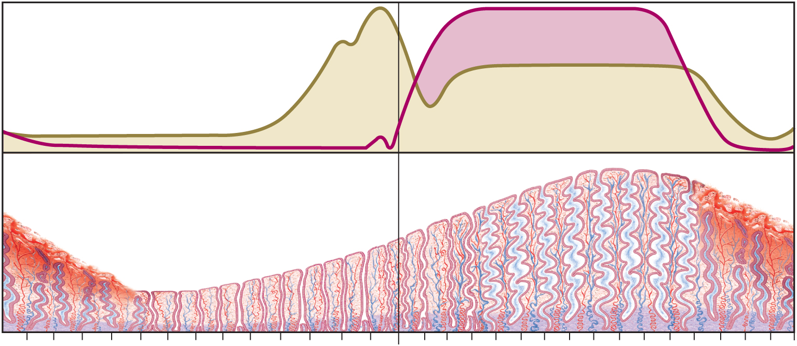
Menstrual Cycle - Proliferative Phase
Copyright © The McGraw-Hill Companies, Inc. Permission required for reproduction or display.
(b) Menstrual cycle
Progesterone
Ovarian hormone secretion
Estradiol
Menstrual
fluid
Thickness of endometrium
Days
1
3
5
7
9
11
13
15
17
19
21
23
25
27
1
Menstrual phase
Proliferative phase
Secretory phase
Premenstrual
phase
Figure from: Saladin, Anatomy & Physiology, McGraw Hill, 2018
Figure 28.14b

Slide 12
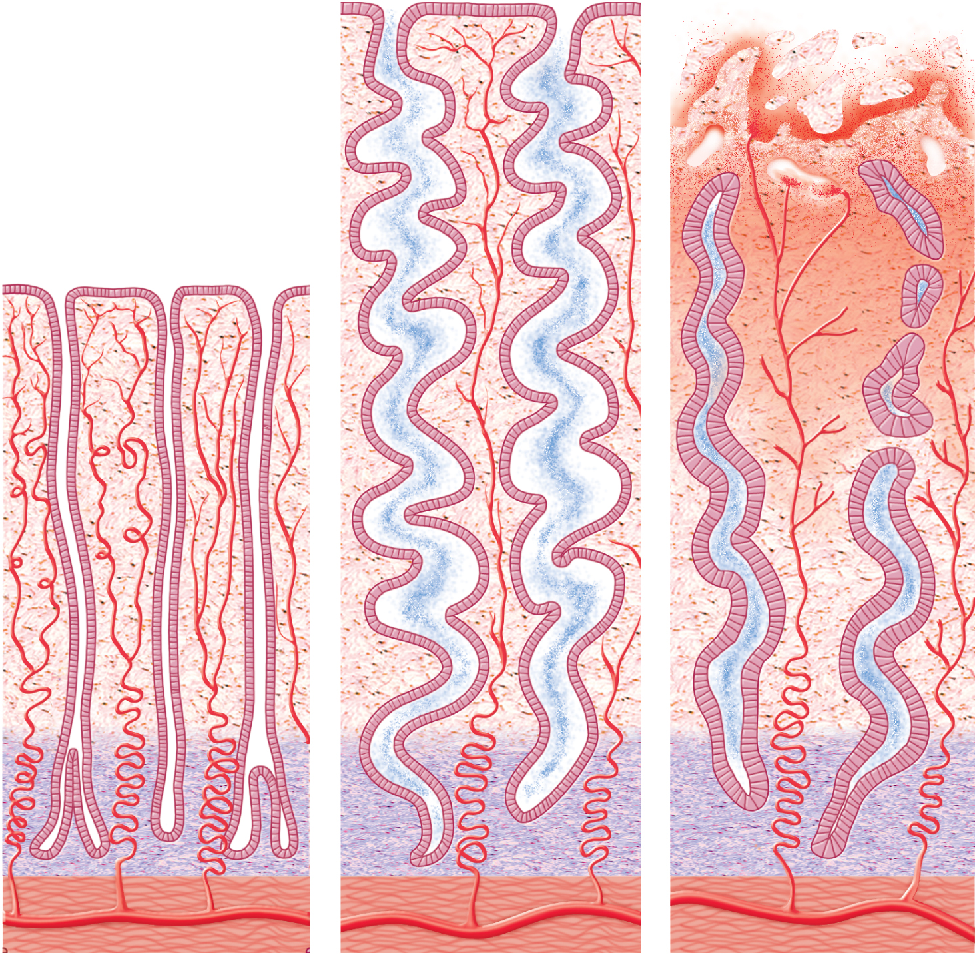
Endometrial Changes
Copyright © The McGraw-Hill Companies, Inc. Permission required for reproduction or display.
Figure from: Saladin, Anatomy & Physiology, McGraw Hill, 2018
Secretion
Endometrial
gland
Stratum
functionalis
Spiral artery
Stratum
basalis
Myometrium
(a) Proliferative phase
(b) Secretory phase
(c) Menstrual phase
Figure 28.16

Slide 13
Female Sexual Response
physiological changes that occur during intercourse
excitement and plateau
labia minora becomes congested and often protrude beyond the labia majora
labia majora become reddened and enlarged
vaginal transudate – serous fluid that seeps through the walls of the canal
greater vestibular gland secretion moistens the vestibule and provides lubrication
the orgasmic platform lower 1/3 of vagina constricts
narrower canal and vaginal rugae enhance stimulation and help induce orgasm in both partners
tenting effect – uterus stands nearly vertical, where normally it tilts forward over the bladder
breasts swell and nipples become erect
stimulation of the erect clitoris brings about erotic stimulation
Al-Farabi Kazakh National University
Higher School of Medicine

Slide 14
Female Sexual Response
orgasm – intense sensation spreading from the clitoris through the pelvis
sometimes with pelvic throbbing and a spreading sense of warmth
pelvic platform gives three to five strong contractions about 0.8 sec apart
cervix plunges spasmodically into vagina and pool of semen
uterus exhibits peristaltic contraction
anal and urethral sphincters constrict
paraurethral glands (homologous to the prostate) sometimes expel copious fluid similar to prostatic fluid (female ejaculation)
tachycardia, hyperventilation
sometimes women experience reddish, rash-like flush that appears on the lower abdomen, chest, neck, and face
Al-Farabi Kazakh National University
Higher School of Medicine

Slide 15
Female Sexual Response
resolution
the uterus drops forward to its resting position
orgasmic platform quickly relaxes
flush disappears quickly
areolae and nipples undergo rapid detumescence
postorgasmic outbreak of perspiration
women do not have refractory period
list the key difference between male and female sexual response?
Al-Farabi Kazakh National University
Higher School of Medicine

Slide 16
Reference:
Saladin, Anatomy & Physiology, McGraw Hill, New York,2018
National center for case study teaching in science. https://sciencecases.lib.buffalo.edu/

